Slide 1

INSTITUTE OF AERONAUTICAL ENGINEERING
EX-EED PRESENTATION – 2024
CSE(DATA SCIENCE) DEPARTMENT – B
ROLL NO.S: 22951A67B6, 22951A67B9, 22951A67A2

Slide 2

Design Your Dream Home: The Ultimate House Interior Designer App

Slide 3

Welcome to Dream Home
Get ready to design your dream home with the ultimate house interior designer app.
Create the perfect space that reﬂects your style and personality.

Slide 4

Explore countless design options for every room in your house. From cozy bedrooms to functional kitchens, the app offers a wide range of styles and themes.
Endless Possibilities

Slide 5

Customize Every Detail
Personalize your space by selecting the perfect furniture pieces, color schemes, and decorative accents. Let your creativity run wild and bring your vision to life.

Slide 6
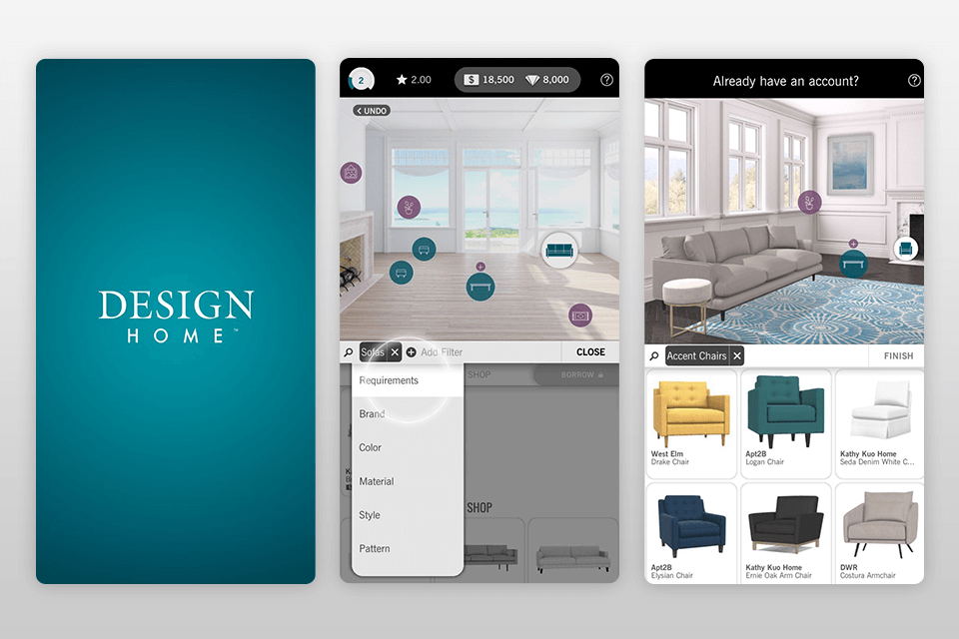

Slide 7
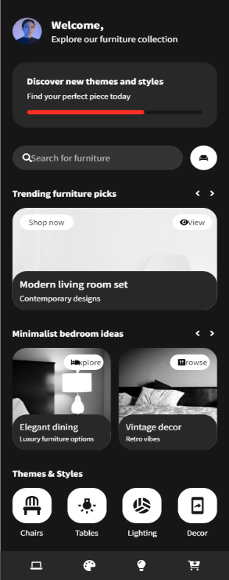
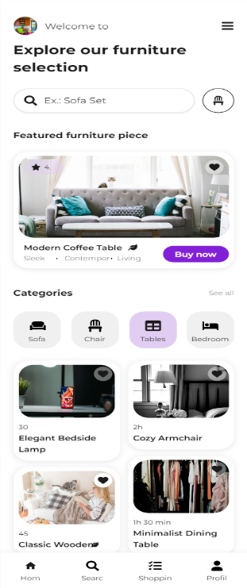
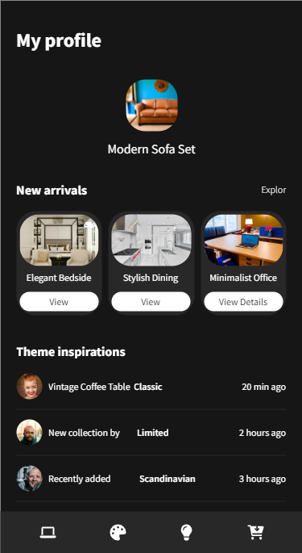

Slide 8
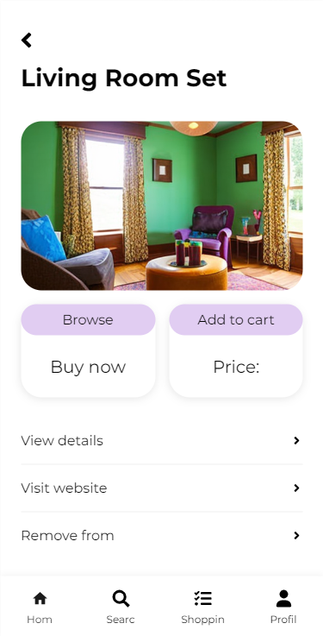
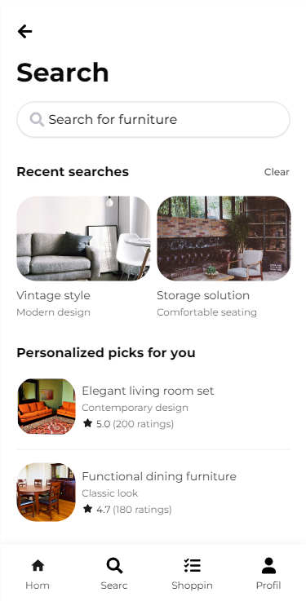
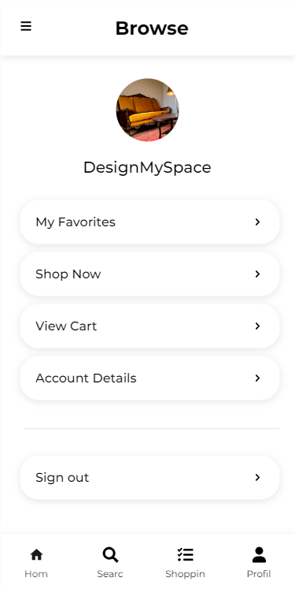

Slide 9
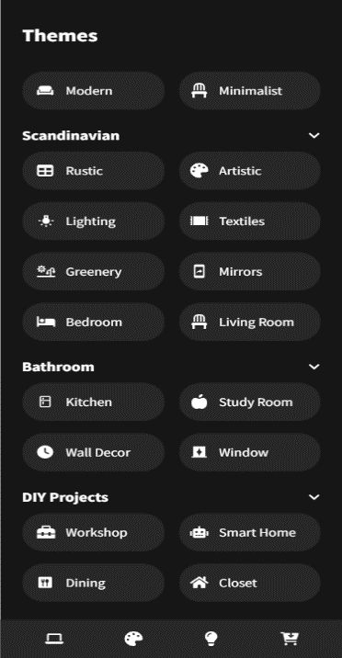
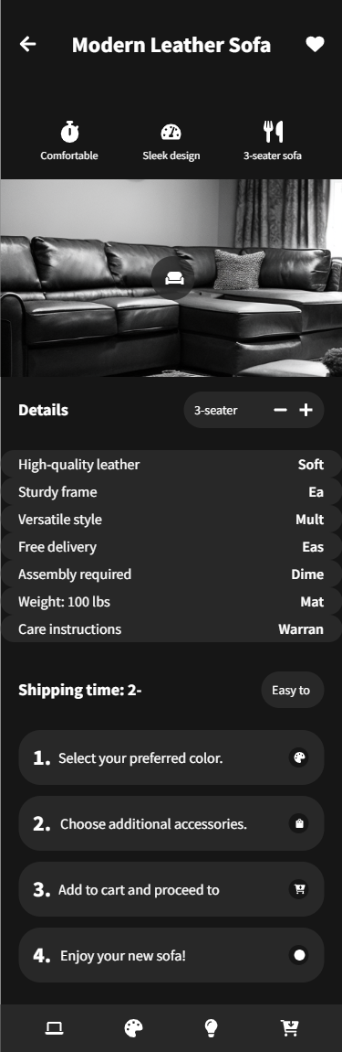

Slide 10
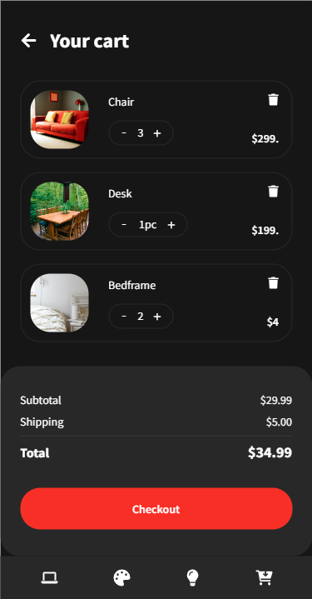
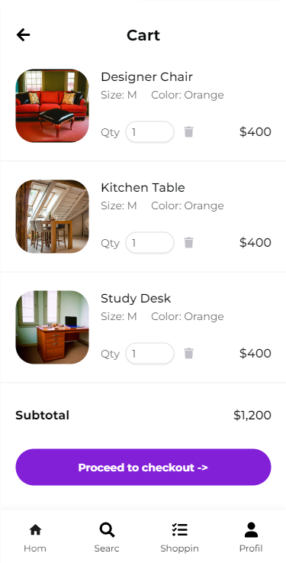

Slide 11

Visualize in 3D
Experience a realistic 3D visualization of your design ideas. Walk through your dream home and see how each element comes together in a stunning, immersive environment.

Slide 12
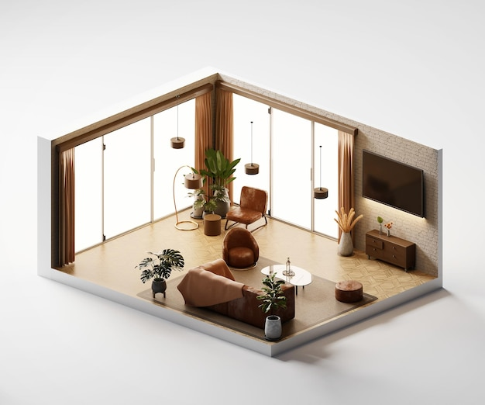
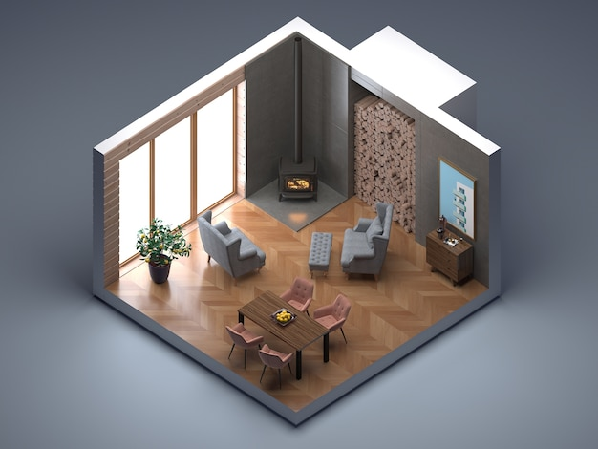

Slide 13
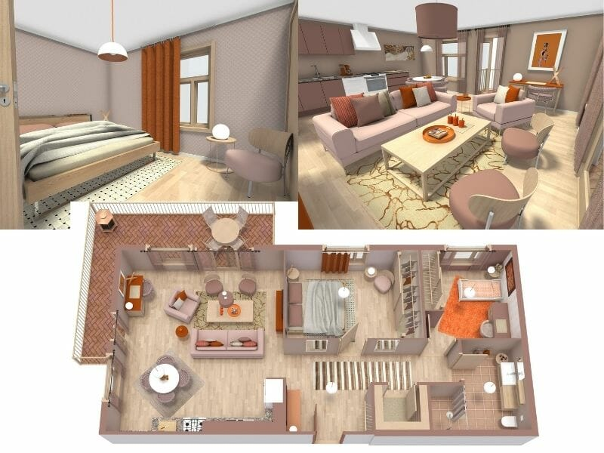

Slide 14

Collaborate with Experts
Connect with professional designers and get expert advice on your projects. Receive personalized recommendations and tips to elevate your interior design game.

Slide 15

Showcase your designs and gather feedback from the community. Get inspired by others' creations and contribute to a vibrant and supportive network of home design enthusiasts.
Share and Inspire

Slide 16

Easily export your designs and seamlessly integrate them into your renovation or construction projects. Make your dream home a reality with the help of our intuitive app.
Seamless Integration

Slide 17

Start Designing Today
Unleash your creativity and embark on an exciting journey to design your dream home.
Download the ultimate house
interior designer app and turn your vision into a stunning reality!

Slide 18
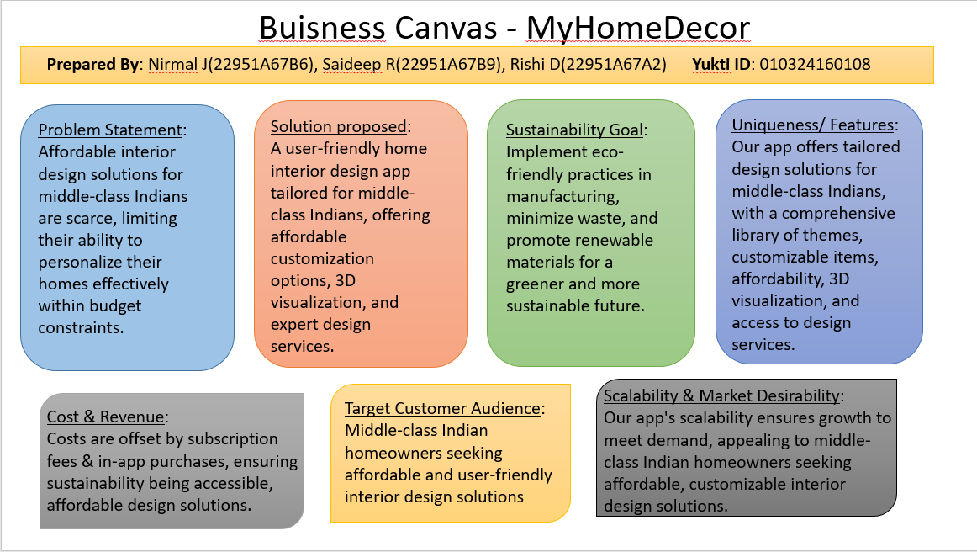

Slide 19
Thanks!
Do you have any questions?

